Slide 1


Erasmus+ Capacity Building in Higher Education
Strengthening innovative social
entrepreneurship practices for disruptive business settings in Thailand and Myanmar
Projectref.: 609711-EPP-1-2019-1-AT-EPPKA2-CBHE-JP
Duration: 36 Months (15/01/2020-14/01/2023)
February 03-05, 2021

Slide 2





Slide 3

Who is here?

Slide 4


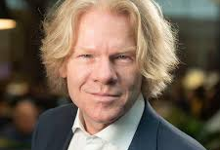
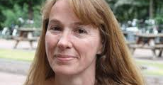


BUas Team (Breda University of Applied Sciences)

Slide 5




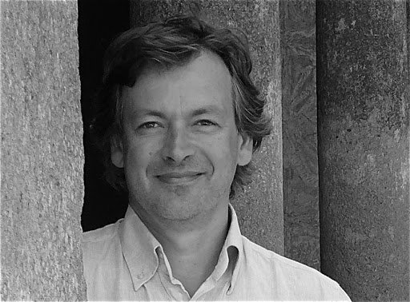
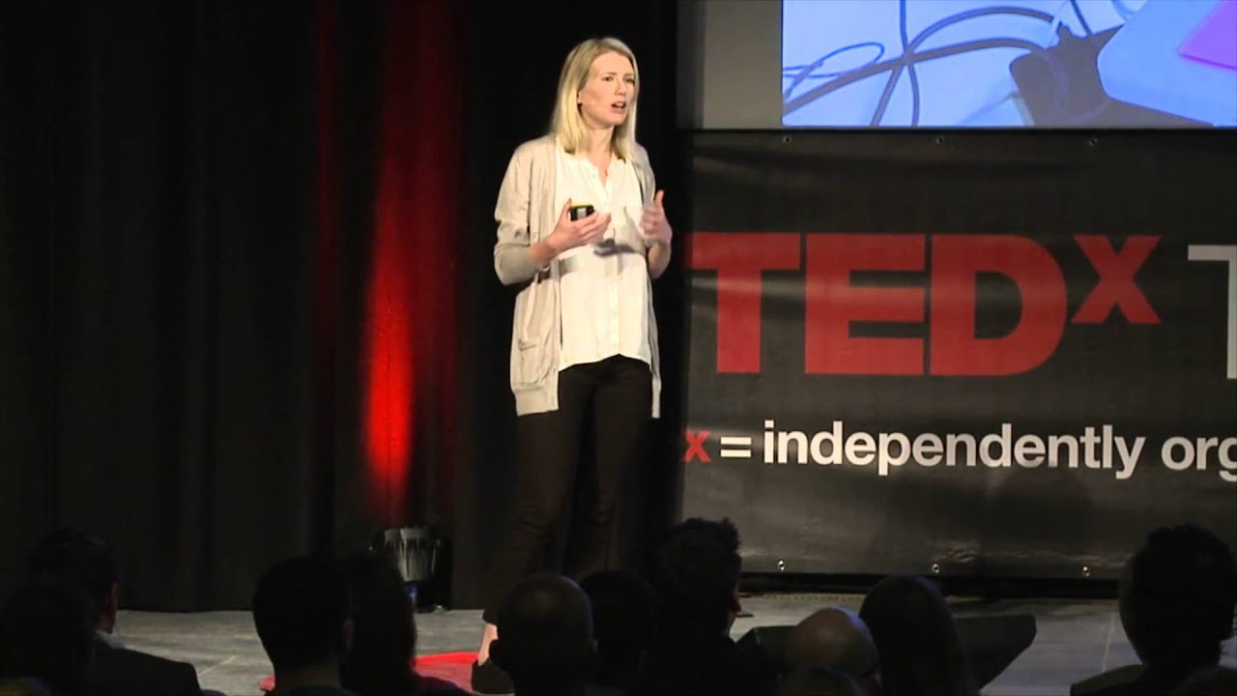
Our guests

Slide 6
Training 3 Roadmap Day 1

Slide 7
Training 3 Roadmap Day 2

Slide 8
Training 3 Roadmap Day 3

Slide 9

LET’S PLAY

Slide 10
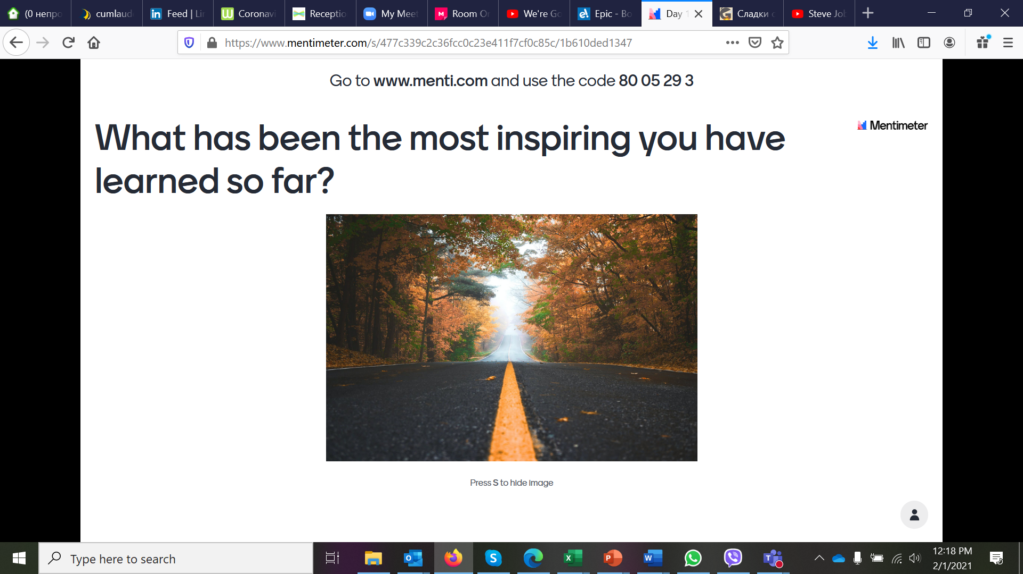

Slide 11
Recap
<
EFFICIENCY / COSTS
VALUE CREATION

Slide 12


Social Business Canvas
Marketing & Communication | Distribution ü | Product / Service and its Value Proposition ü |  | Competitors ü | Customer Segments
Cost Structure |  |  | Revenue Streams ü
ü
Customer Perspective
ü

Slide 13
Social Business Canvas
Marketing & Communication will you need? | Distribution | Product/Service and its Value Proposition |  | Competitors | Customer Segments
Cost Structure |  |  | Revenue Streams
What resources will you need?
Through which channels will your customers want to be reached?
Who will be your strategic logistic partners?
….
Who are your direct competitors?
Who are your indirect competitors?
How your competitors fulfill customer needs?
What is your USP (unique selling proposition)?
……
Who are you?
What do you do?
Why does that matter?
What is your brand essence?
Who are our audiences?
What do you want them to think and feel about you?
How can you achieve that?
Who are the people who will buy your product / service?
(Age, living in a city/village, family status, sex, education etc.)
Where does he/she get information from?
On what basis do they make purchase decisions?
……
What are the features of your product / service?
What is the core of your product / service?
Of what elements does your product / service consist of?
What do you offer, that is different from other products / services?
…….
Customer Perspective
What are the major cost drivers? (People, production, distribution, design, materials, technology… etc.)
What are your major value-drivers?
For what value are your customers willing to pay?
What are the sources of revenue?
What and how will the customers pay?
Will you offer a donor package?
…

Slide 14


Social Business Canvas
Social Challenge | Beneficiaries | Beneficiaries Potential Input ü | Partners ü
 | Core Activities ü
Resources ü |  | Desired Future State / Outputs
ü
ü
Beneficiary Perspective

Slide 15
Social Business Canvas
Social Challenge What is the present situation (numbers, scale of problem, geographical area etc.)? What are the root causes of the problem? What are the factors contributing to the problem? Are there any local problem solutions? …… | Beneficiaries Who are your target beneficiaries (age, sex, location, education, work experience, material status, registered in other foundations/social care organizations)? What are their needs? …. | Beneficiaries Potential Input What are your core activities? What core activities are for your beneficiaries? ….. | Partners What social partners do you want to cooperate with? What business partners will you need? What institutional partners will you involve? What know-how will they give you? How will you build relationships with your partners? ….
 | Core Activities What are your core activities? What the core activities are for you beneficiaries? …
Resources What human resources will you need? What material resources will you need? What financial resources will you need? What know-how will you need? …. |  | Desired Future State / Outputs
Beneficiary Perspective
What needs of the target beneficiaries will you satisfy?
What problem(s) will you solve for your target beneficiaries?
What network or ecosystem will be created?
…

Slide 16

10 minutes

Slide 17


Slide 18
10 minutes

Slide 19
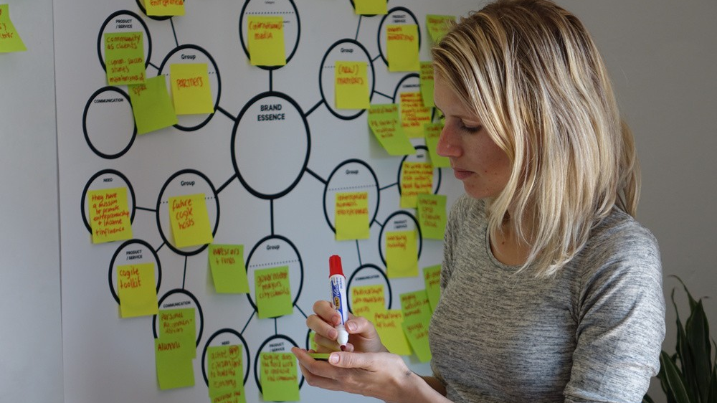

Slide 20
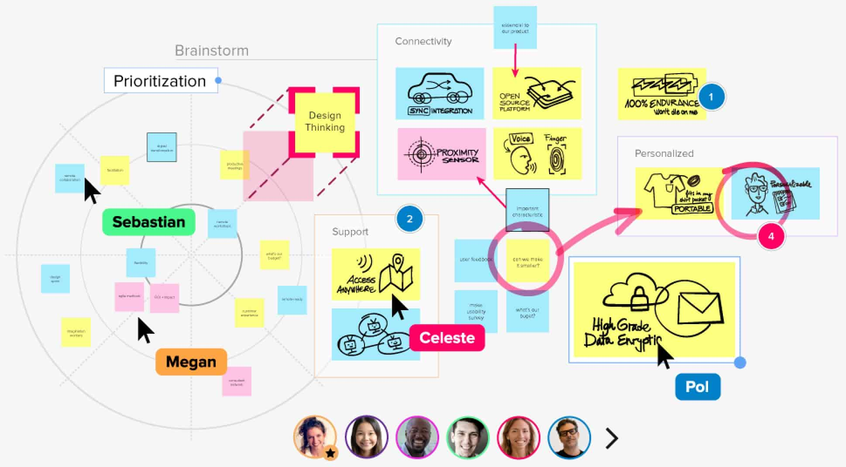

Slide 21
15 minutes

Slide 22


Slide 23

WRAP-UP

Slide 24
Erasmus+ Capacity Building in Higher Education
Strengthening innovative social
entrepreneurship practices for disruptive business settings in Thailand and Myanmar
Projectref.: 609711-EPP-1-2019-1-AT-EPPKA2-CBHE-JP
Duration: 36 Months (15/01/2020-14/01/2023)

